Slide 1
CO2 EMISSION ANALYSIS

Slide 2
The need for CO2 emission study
Helps us understand and address the issue of climate change by identifying major sources of emissions
Allows For Mitigation stratergies
Businesses can use CO2 emissions data to evaluate their environmental impact
Understanding the sources and impacts of CO2 emissions helps raise public awareness about climate change

Slide 3
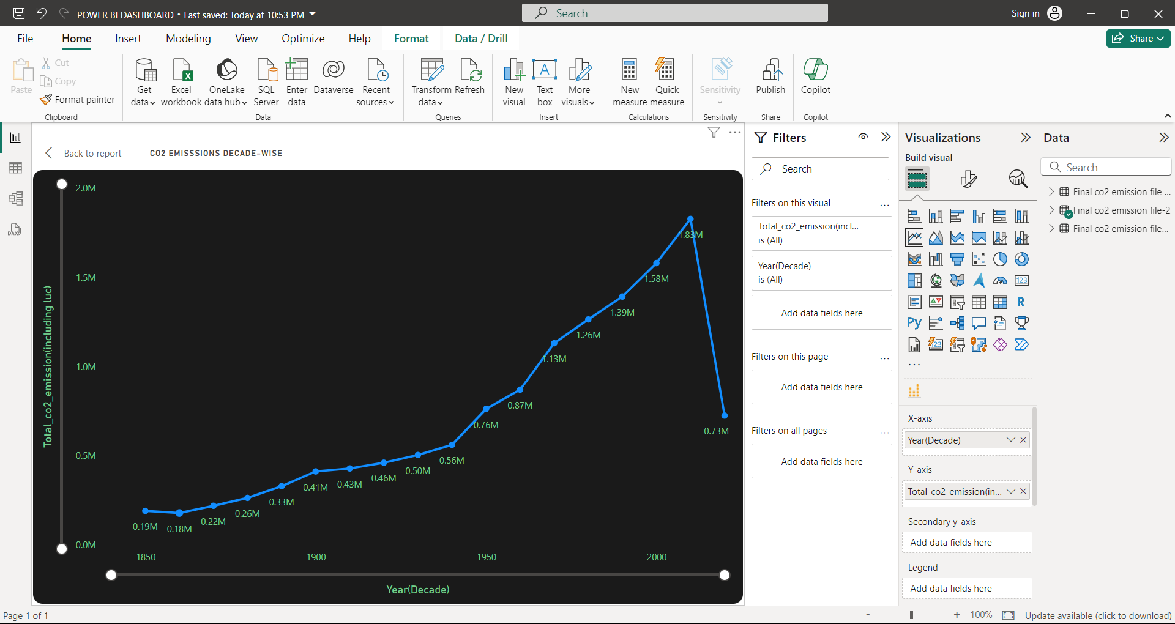
C02 Emission over years
Gradual Increase (1850–1950):
CO₂ emissions remained relatively low during the earlier decades, increasing slowly from 0.19M in 1850 to around 0.56M by 1950.
This reflects the early industrial revolution and gradual expansion of fossil fuel use.
Rapid Growth (1950–2000):
After 1950, emissions grew exponentially, reaching a peak of approximately 1.83M.
This period aligns with post-World War II industrialization, economic growth, and increased reliance on fossil fuels.
Sharp Decline (Post-2000):
A steep drop in CO₂ emissions is visible, falling to 0.73M.
This could signify shifts toward renewable energy, stricter environmental regulations, or economic changes leading to reduced emissions.

Slide 4
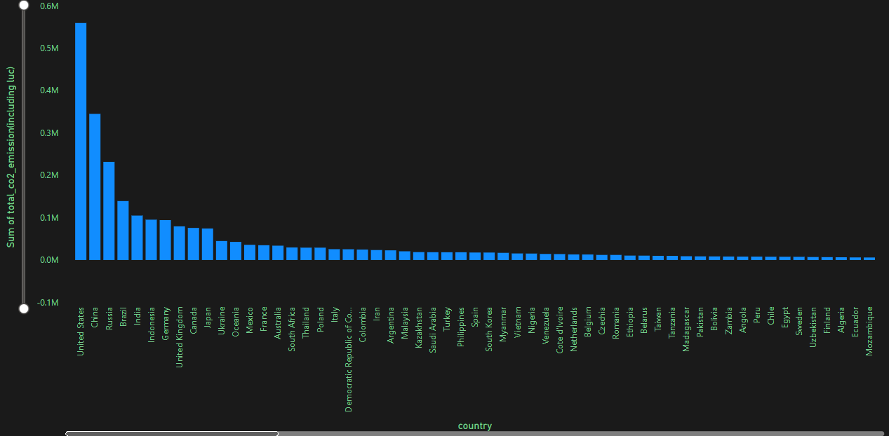
Country Wise Emissions
Top Contributors:
The United States leads with the highest CO₂ emissions, exceeding 0.6 million metric tons.
China, Russia, India, and Brazil follow, showing significant contributions but with a notable gap compared to the United States.
Mid-level Contributors:
Countries like Germany, United Kingdom, Canada, and Japan contribute moderate amounts of emissions, likely due to industrialization and energy usage.
Emissions gradually decrease as we move down the chart.
Lower Emitters:
Towards the end, countries such as Mozambique, Ecuador, and Finland contribute minimal emissions. These may represent less industrialized nations or those with greener energy policies.

Slide 5
Sector Wise C02 Emission

Slide 6
Sector Wise C02 Emission Contd..
Land Use Change CO₂
Largest contributor among sectors, with emissions exceeding 4.5 million tonnes.
Likely includes deforestation, agricultural expansion, and other changes in land use that release stored carbon into the atmosphere.
Coal CO₂ Emissions Second largest source of emissions, slightly below land use change, reflecting the heavy reliance on coal as an energy source.
Indicates its significant role in industrial processes, power generation, and heating.
Oil CO₂ Emissions A significant contributor, with emissions around 3 million tonnes.
Associated with transportation, industrial use, and energy production.
Gas CO₂ Emissions Moderate contributor compared to coal and oil, around 1.5 million tonnes.
Represents emissions from natural gas consumption for heating, electricity, and industrial purposes.
Cement CO₂ Emissions
A smaller, yet notable sector contributing emissions.
Associated with the production of cement, which involves the release of CO₂ during the chemical process.
Flaring CO₂ Minor contributor compared to other sectors, likely related to gas flaring during oil extraction.
Other Industry CO₂ Emissions
Represents miscellaneous industrial activities contributing relatively low CO₂ emissions.

Slide 7
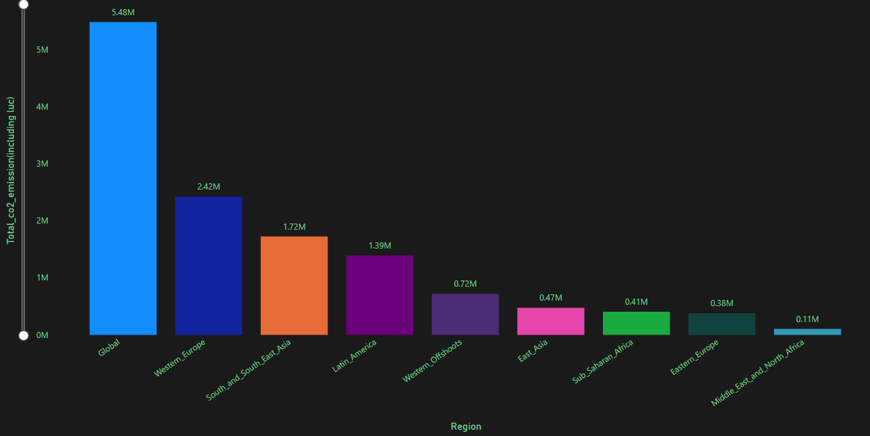
Region Wise Emissions
Western Europe and South/Southeast Asia are major contributors among specific regions.
Middle East and North Africa show the lowest emissions, reflecting lower industrial activity or population size.

Slide 8
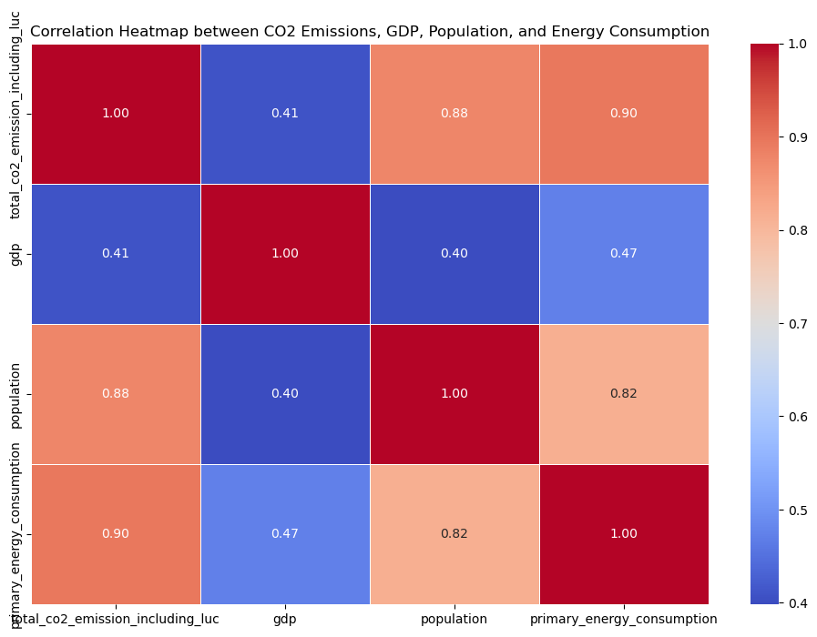
Corelation Between selected variables
Energy use and CO2 emissions are very tightly linked, suggesting that current energy production methods are still heavily carbon-dependent
Population size has a strong influence on both emissions and energy consumption
Surprisingly, GDP (economic output) has much weaker connections with emissions, energy use, and population, suggesting that economic development doesn't necessarily mean proportionally higher emissions or energy use

Slide 9
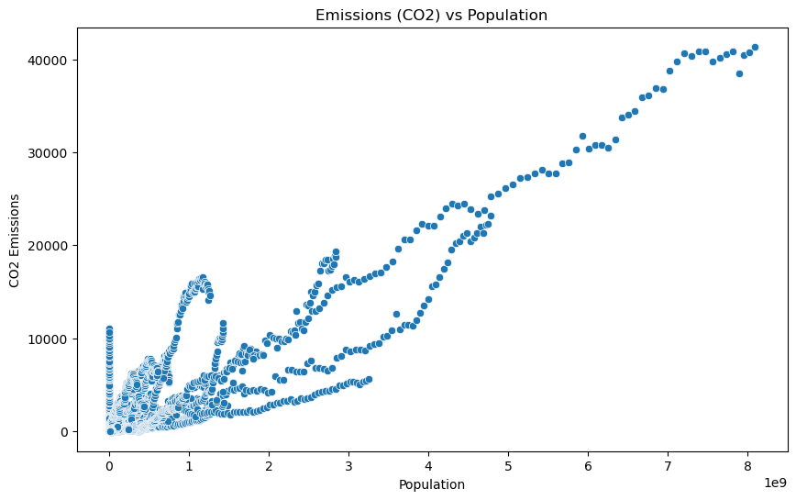
Corelation Between selected variables
Energy use and CO2 emissions are very tightly linked, suggesting that current energy production methods are still heavily carbon-dependent
Population size has a strong influence on both emissions and energy consumption
Surprisingly, GDP (economic output) has much weaker connections with emissions, energy use, and population, suggesting that economic development doesn't necessarily mean proportionally higher emissions or energy use

Slide 10
THANK YOU

